Slide 1


Slide 2
Huffman Coding
Huffman coding is a way of encoding characters into a sequence of 0s and 1s.
Huffman coding generates a set of codes based on the frequency of occurrence of the characters. When the data is coded using these characters, the resulting encoding has a shorter length compared to an encoding that uses 8 bits to encode the data.

Slide 3
The Problem
Encoding symbols using bits: Encoding scheme that takes text written in alphabets & converts this text into long string of bits.
Ex: 26 letters in English + space + ! + . + ? +’ = 32 symbols
i.e 2 pow b sequences. So b =5.
Ie each alphabet will be 5 bits long.
We couldn’t ask to encode each symbol using 4 bits.
Letters do not get used equally frequently.

Slide 4
Letters e, t, a, o, I, n get used much more frequently than q, j, x, z.
So it’s a waste to translate them all into same number of bits. Instead use small number of bits for frequent letters and large number of bits for less frequent ones and end up using fewer than 5 bits per letter when we average over long string of typical text.

Slide 5
Variable length encoding scheme
Before internet, radio, telephone, digital computer
Telegraph was used
It is capable of transmitting pulses down a wire. So to send message encode the text into sequence of pulses (Morse Code)
Translate each letter into dots and dashes.
Encode frequent letters with short strings
Asked printing press people to get frequency estimates for letters in English.

Slide 6
Morse code maps e to 0 (DOT) t to 1 (DASH) a to 01.
In general morse code maps more frequent letters to shorter bit strings.
Morse code is applied on letters/Alphabets and not on Words
ex eta 0101 aa, eta, etet or ate
To handle this morse code transmission involved shorter pauses between letters.
ex aa .- pause .-
But it actually means that we haven’t encoded the everything usinfg only bits 0,1 and pause.
So if we want to encode everything using only the bits 0 and 1 we need to have some further encoding in which pause got mapped to bits.

Slide 7
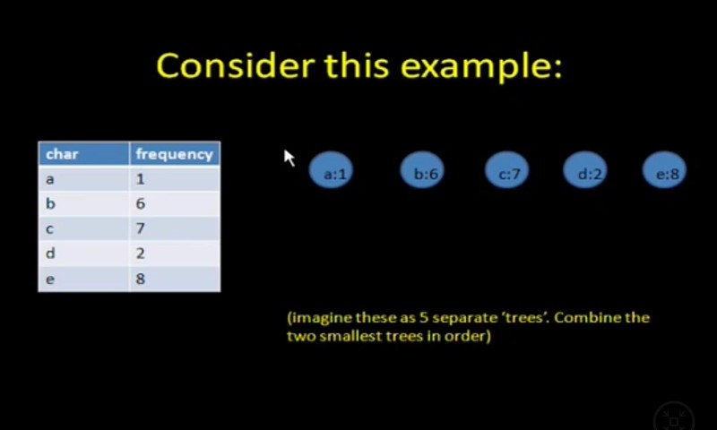

Slide 8
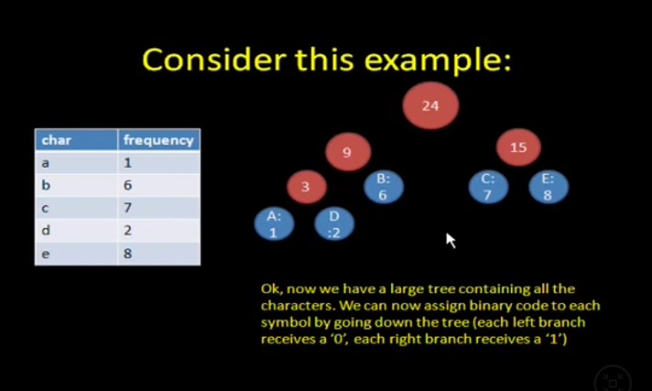

Slide 9
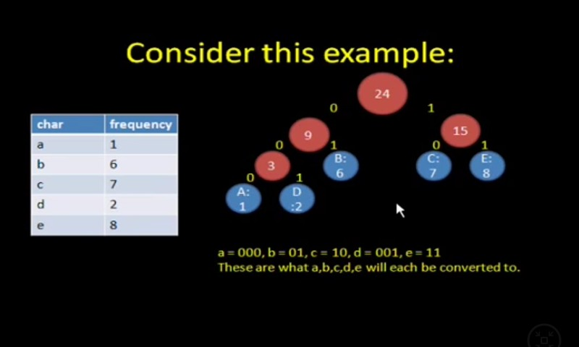

Slide 10
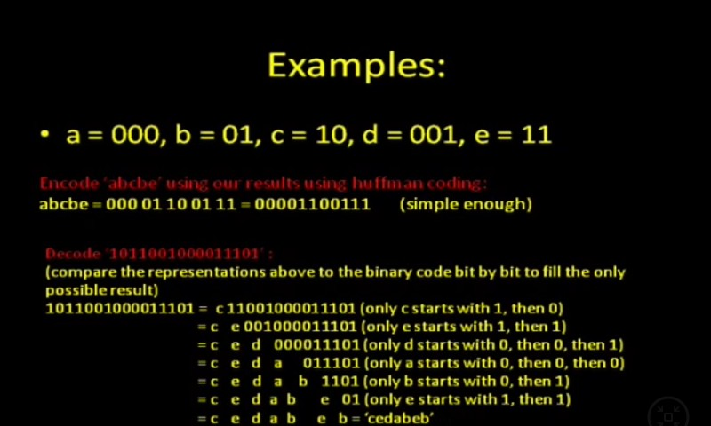

Slide 11
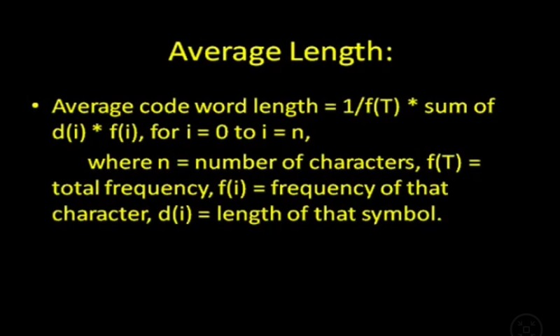

Slide 12
